Slide 1



JA115 Principal Component Analysis PCA Academic Year 2022-23
John Abela
Department of CIS
john.abela@um.edu.mt
+ 365 79367936
Room 1A/27
FICT Building
©John Abela, 2018-2022
Faculty of
ICT
Department of
Computer Information Systems
Last Updated
18-Oct-2022

Slide 2
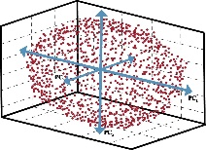

Core Topics
2
Principal
Component
Analysis
‘Core Topic’ modules are those that are used in more than one study unit. They may also be short revision or ‘transition’ topics.
JA101 – What is AI?
JA102 – Big Data Analytics
JA103 – Machine Learning - Principles & Concepts
JA104 – Discrete Mathematics for DS&A.
JA105 – Backpropagation Neural Networks I & II
JA106 – Statistics & Probability
JA107 – Cryptography
JA108 – Blockchain & DLTs
JA109 – Deep Learning & Convolutional Neural Networks
JA110 – Fourier Transforms
JA111 – Quantum Computing I & II
JA112 – Decision Trees and the ID3 Algorithm
JA113 – Eigen Values and Eigen Vectors
JA114 – Data Clustering
JA115 – Principle Component Analysis

Slide 3
JA115 – Principal Component Analysis
3
Principal
Component
Analysis
This ‘Core Topic’ module is used in the following study units.
CIS2350 – Business Applications of AI
CIS5003 – Principles of Data Science
CIS5004 – Programming in Python and Principles of Data Science
ICS2207 – Machine Learning: Introduction to Classification, Search and Optimisation

Slide 4
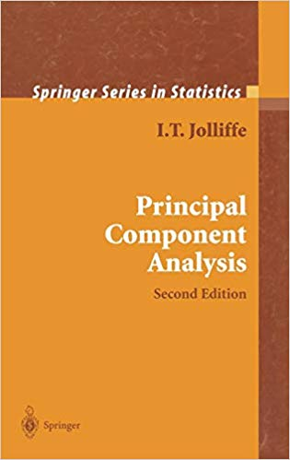
Pre-Requisites & Textbook
4
Principal
Component
Analysis
Students as assumed to be familiar with basic matrix and vector arithmetic and basic differential calculus.
We will cover the main concepts and ideas from the above.
The main reference textbook is Principal Component Analysis (Springer Series in Statistics) 2nd Edition
October 1, 2002 by I.T. Jolliffe (Author).
ISBN-13: 978-0387954424

Slide 5



Special Notes and Some Links
5
Principal
Component
Analysis
Many of the slides were motivated and inspired by the excellent Youtube video by Luis Serrano. https://www.youtube.com/watch?v=g-Hb26agBFg
“I believe that mathematical concepts can be learned through simple explanations, analogies and easy-to-understand visualizations. I am passionate about teaching these concepts in relatable, friendly, and simple ways.”
Luis Serrano
Another very highly recommended video is the 3Blue1Brown Youtube video on Eigenvectors and Eigenvalues. https://www.youtube.com/watch?v=PFDu9oVAE-g

Slide 6
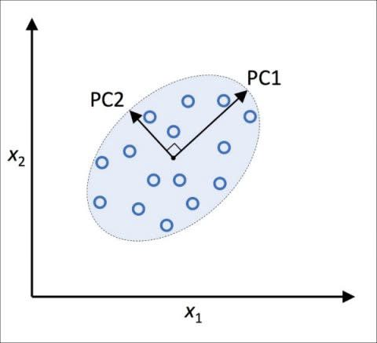
Topic Roadmap
6
Principal
Component
Analysis
Introduction & Motivation.
The Curse of Dimensionality.
Dimensionality Reduction.
Revision
Linear Transformations.
Mean, Variance, Covariance.
Covariance Matrices.
Eigenvectors & Eigenvalues.
Principal Component Analysis.
Summary and Comments.
“The goal is to turn data into information, and information into insight.”
Carly Fiorina, former CEO of Hewlett-Packard

Slide 7
Introduction & Motivation
7
Principal
Component
Analysis
Principal Component Analysis (PCA) is a technique that is useful for the compression and classification of data. An important use is to reduce the dimensionality of a data set (sample) by finding a new set of variables, smaller than the original set of variables, that nonetheless retains most of the sample's information.
By information we mean the variation present in the sample, given by the correlations between the original variables. The new variables, called principal components (PCs), are uncorrelated, and are ordered by the fraction of the total information each retains.
PCA is a very popular for the purpose of dimensionality reduction and also to determine which features (columns) are most important.

Slide 8
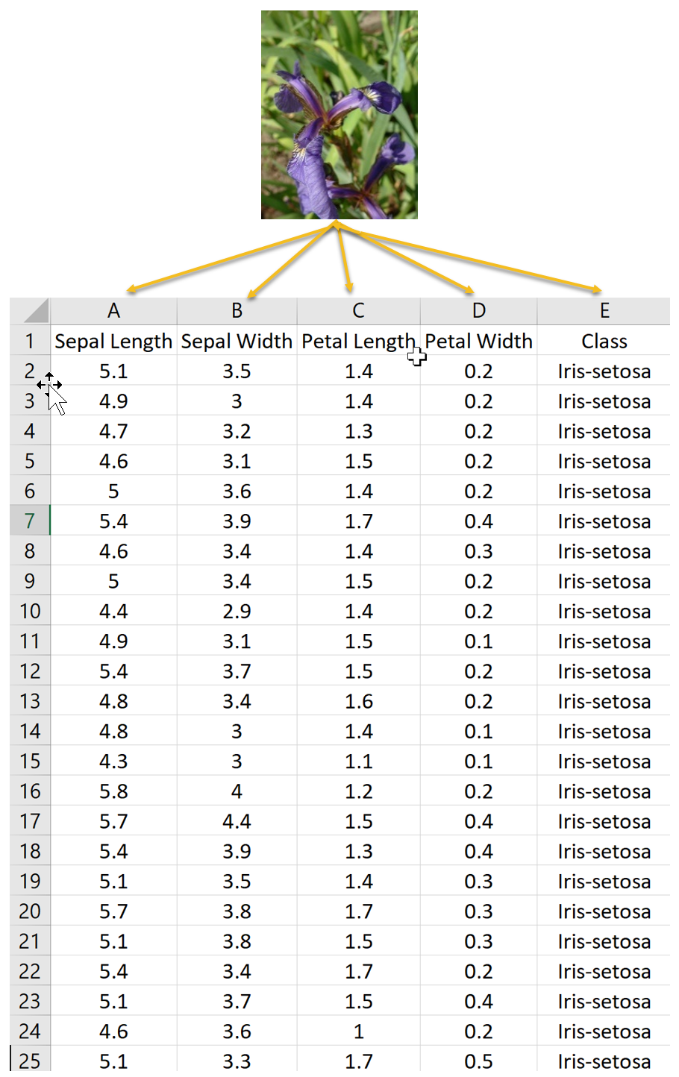
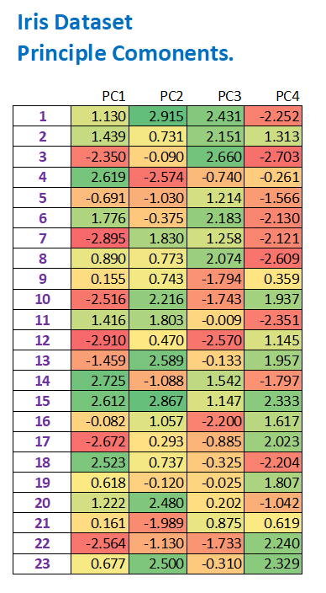
What does PCA do?
8
Principal
Component
Analysis
PCA can be used to transform numeric data only – such as the Iris dataset.
The numeric columns, except the label, are input to the PCA algorithm.
The 4 variables in the Iris dataset are transformed into 4 new ‘variables’ called Principle Components.
These are ordered left-to-right by ‘importance’
Note that the values now include negative numbers and seem to make absolutely no sense.
Do not try to make sense of the values.
PCA

Slide 9
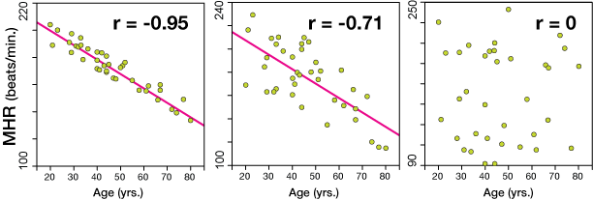
Correlated vs Uncorrelated Data
9
Revision
Principal
Component
Analysis
Correlation is higher when the vector components of each datum move (with or against) together.
In our example the data are points on the Cartesian plane.
Note that in the first dataset the heart rate decreases as age increases. This is called negative correlation.

Slide 10
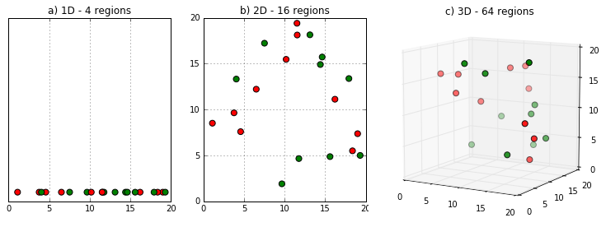
The Curse of Dimensionality
10
Principal
Component
Analysis
Real World data may have thousands, or millions of dimensions (columns or features).
E.g., web documents, where the dimensionality is the vocabulary of distinct words.
Facebook graph, where the dimensionality is the number of users.
The huge number of dimensions can cause a lot of (computational) problems.
The data become very sparse and some data analytics algorithms become meaningless (e.g. density based clustering).
The time and space complexity of several algorithms are a function of the dimensionality of the data and they therefore become computationally infeasible as the dimension grows.

Slide 11

Dimensionality Reduction
11
Principal
Component
Analysis
Sometimes the data can be described with fewer dimensions, without losing much of the meaning of the data.
The data will be mapped to a vector space of lower dimensionality.
Essentially, we are assuming that some of the data is noise, and we can approximate the useful part in a lower dimensionality space.
Dimensionality reduction does not just reduce the amount of data, it often brings out the useful part of the data.
You (almost) always lose some information when you perform dimensionality reduction.
Dimensionality Reduction includes the following:
Feature (column) elimination – essentially you throw features away.
Feature (column) compounding – combine two features into 1.

Slide 12
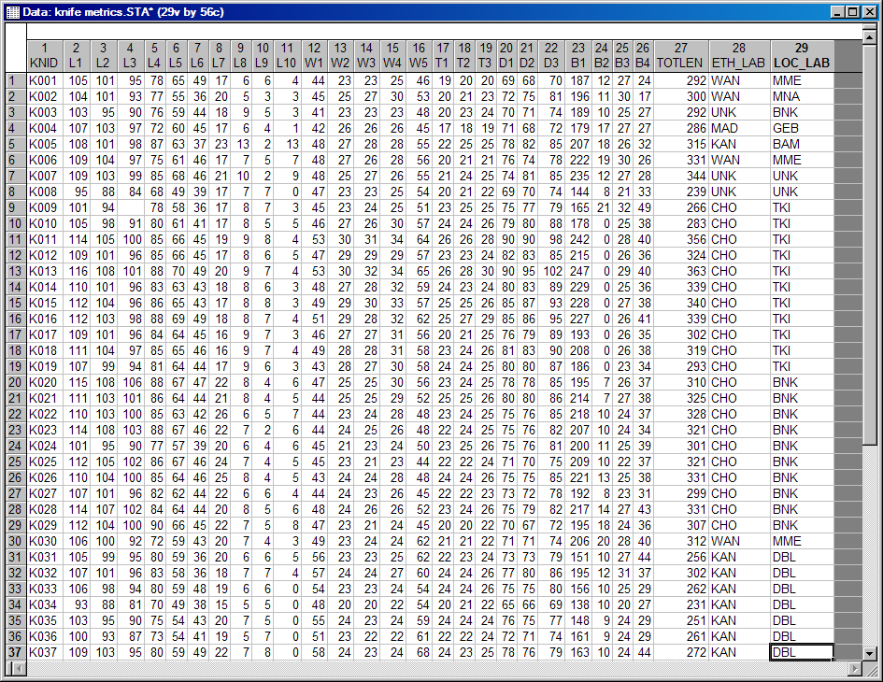
Dimensionality Reduction
12
Principal
Component
Analysis
Columns (features) that are strongly correlated can be merged, or compounded, into a single feature.
Columns (features), such as constants, that do not contribute much to the variation in the dataset are merged with others or else discarded.
Note that you are always throwing some information away.
Hopefully this will not affect the utility of dataset and that the reduction in dimensionality will speedup machine learning algorithms.

Slide 13


Projections & Taking Pictures
13
Principal
Component
Analysis
Suppose we want to take a picture of our friends from an angle that captures as much information as possible.
Which angle preserves the most information?
Taking a picture is a projection from 3-D to 2-D.
Note that the best angle is the one that, statistically, preserves the most variance or ‘spread’.
When we ‘project’ the 3-D scene to a 2-D representation (photo) we try to lose as little data as possible.
Diagram by Luis Serrano

Slide 14

14
Principal
Component
Analysis
Consider Housing Data….
Suppose we had the following columns (features):
Size in m²
Number of Rooms.
Number of Bathrooms.
Schools nearby.
Crime rate.
Note that the first 3 features relate to the size.
The last 2 features relate to neighbourhood.
Can we reduce the number of features to a ‘neighbourhood’ feature and a ‘size’ feature?
Note that composition of features into a single feature only makes sense if the features are correlated.

Slide 15
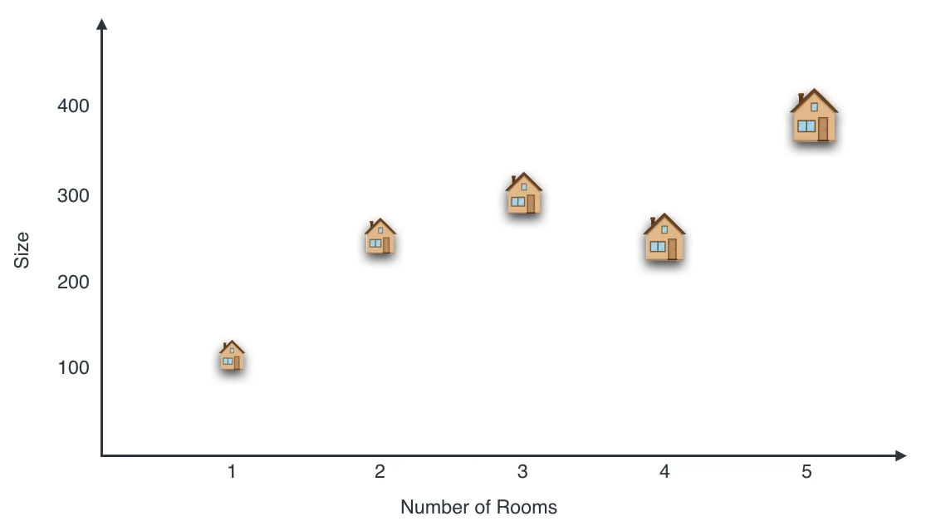
15
Principal
Component
Analysis
Consider Housing Data….
Diagram by Luis Serrano

Slide 16
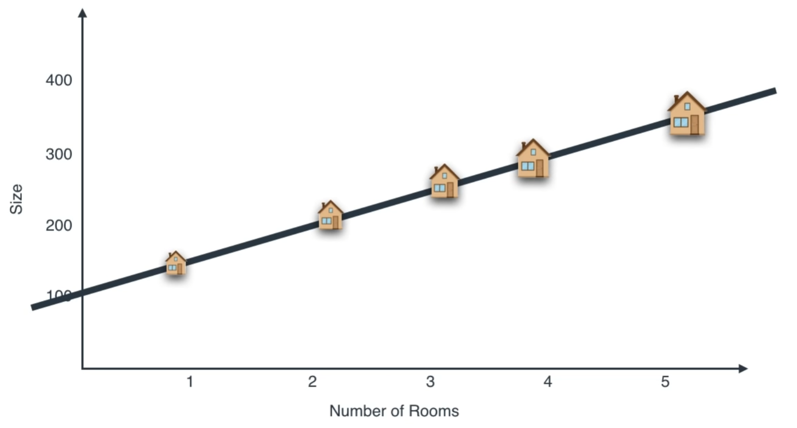
16
Principal
Component
Analysis
Housing Data reduced to a Single Variable
Diagram by Luis Serrano

Slide 17
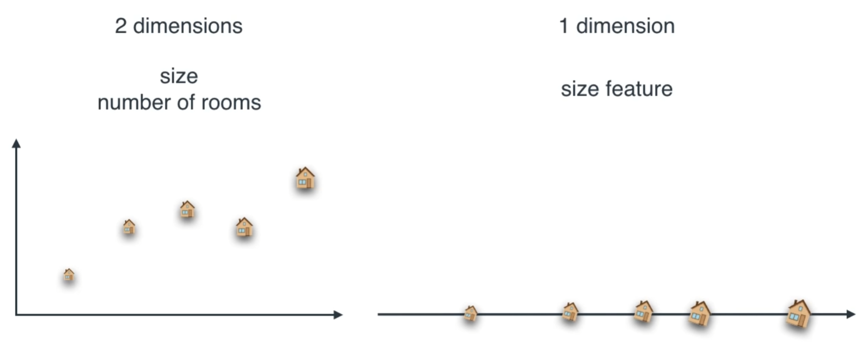
17
Principal
Component
Analysis
Dimensionality Reduction in Housing Data
You only merge features (columns) that are correlated.
Diagram by Luis Serrano

Slide 18


Male Athletes Data Set
18
Principal
Component
Analysis
Suppose we have the following columns (features):
Weight
Height
Eye Colour
Skin Colour
BMI
Which columns correlate (with each other)?
Correlation means that two variables move (increase or decrease) together.
Important
Note that correlation between a column and the class label is different to correlation between 2 columns.

Slide 19
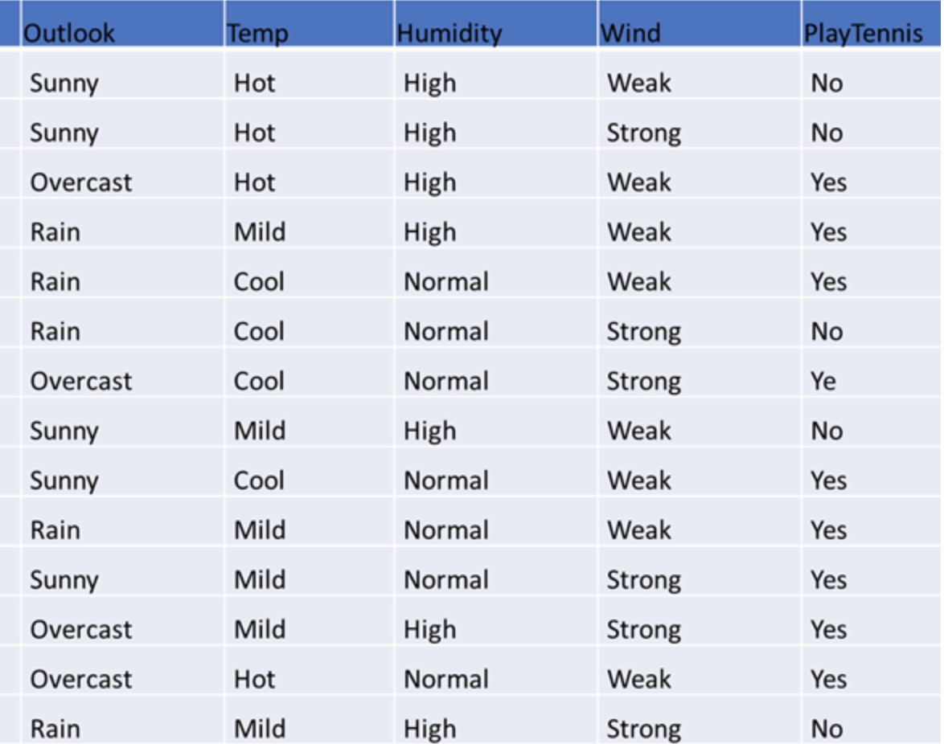
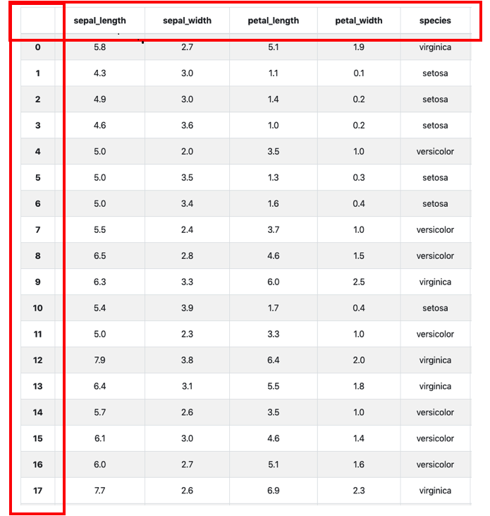
Correlation with Class Label
19
Principal
Component
Analysis
Important - Note that correlation between a column/s and the class label is very different to correlation between 2 columns (features).
Correlation
between a feature and the class label
Correlation
between two features

Slide 20
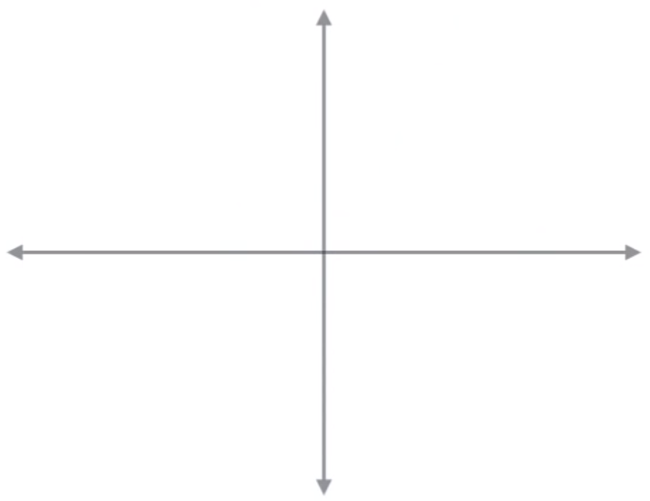
Compounding Features (columns)
20
Principal
Component
Analysis
If two columns (features) are perfectly correlated then they can be merged without losing any information.
If the two columns are perfectly correlated then it means that they ‘move exactly together’.
The two columns can be ‘compounded’ into one new column Z with absolutely no loss of information.
2-D
Data
X | Y
2 | 2
3 | 3
6 | 6
9 | 9
11 | 11
Z
2
3
6
9
11
1-D
Data

Slide 21
Compounding Features (columns)
21
Principal
Component
Analysis
The assumption is that if two columns (features) are strongly correlated then they can be merged without losing too much information.
If the two columns are strongly correlated then it means that they ‘move closely together’.
The two columns can be ‘compounded’ into one new column Z with some loss of information.
X | Y
2 | 2
3 | 3
6 | 6
9 | 9
11 | 11
X | Y
2 | 2
3 | 2.7
6 | 6.3
9 | 8.73
11 | 11
2-D
Data
Z
2
3
6
9
11
1-D
Data

Slide 22
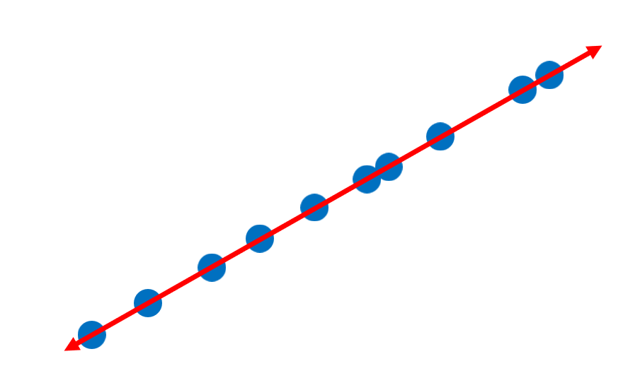
Compounding Features (columns)
22
Principal
Component
Analysis
In our Male Athletes dataset, if two columns (features) are strongly correlated then they can very probably be merged without losing too much information.
For example, height and weight of the athletes.
Height and Weight are then compounded.
Some information is lost but we assume that the information lost was ‘noise’ and will not adversely affect the performance of our machine learning algorithm or classifier.
2-D
Data
1-D
Data

Slide 23
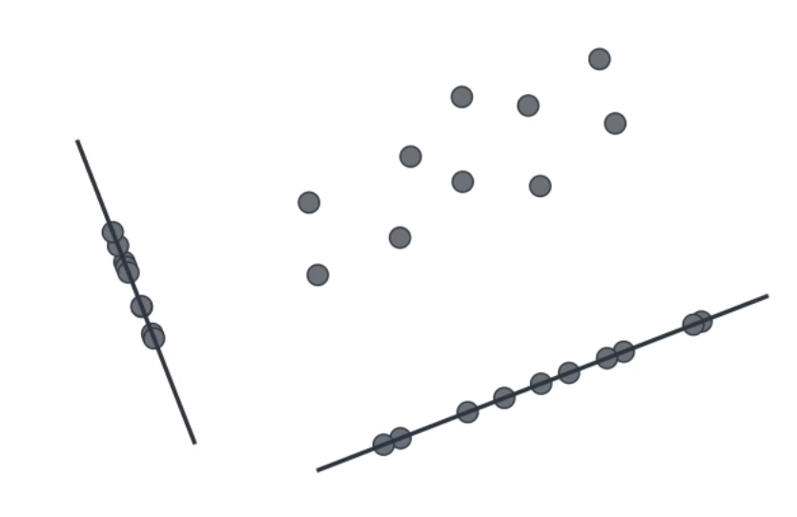
Compounding Features (columns)
23
Principal
Component
Analysis
y-spread
x-spread

Slide 24
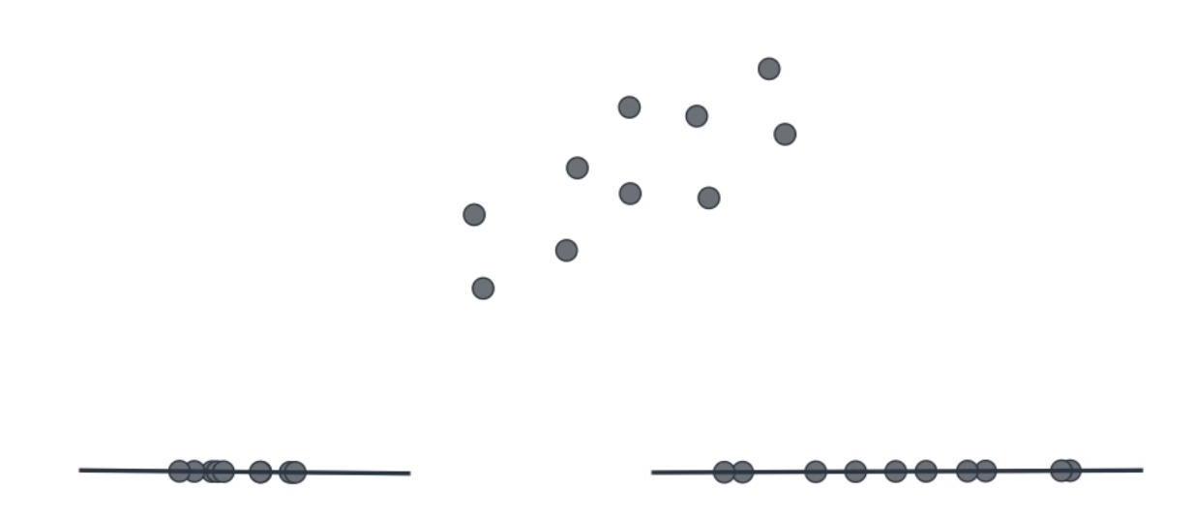
Compounding Features (columns)
24
Principal
Component
Analysis
y-spread
x-spread

Slide 25
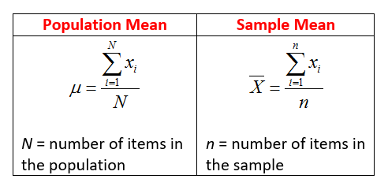
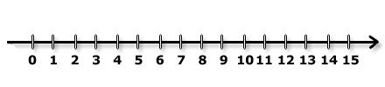
The Mean
25
Principal
Component
Analysis
Suppose we have 3 numbers 2, 5, and 11 as shown on the number line below.
The mean is 2 + 5 + 11 = 18 divided by 3 = 6.

Slide 26


Variance
26
Principal
Component
Analysis
Suppose we have dataset A containing the numbers 45 and 55.
The mean is 50.
Consider also dataset B containing the numbers 1 and 99.
The mean is also 50.
The mean does not tell us anything about the ‘variance’ or how much the data is ‘spread out’.
Afterall, if you have your head in an oven and your feet in a freezer then, on average, you are feeling comfortable.

Slide 27
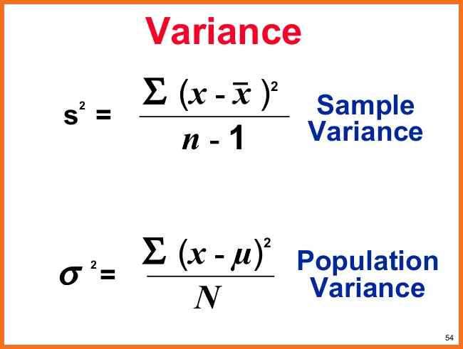
Variance
27
Principal
Component
Analysis
How do we compute the variance?
Again let A = {45, 55} and B = {1, 99}.
The distance of each element of A to the mean (50) is 5.
To compute the variance we square the differences to the mean.
The variance of A is therefore 5² + 5² = 50/2 = 25.
The distance of each element of B to the mean (50) is 49.
The variance of B is therefore 49² + 49² = 4802/2 = 2401.
The variance tells us much more about the ‘spread’ in each dataset.
Note that variance is the square of the standard deviation.
5
5
49
49

Slide 28
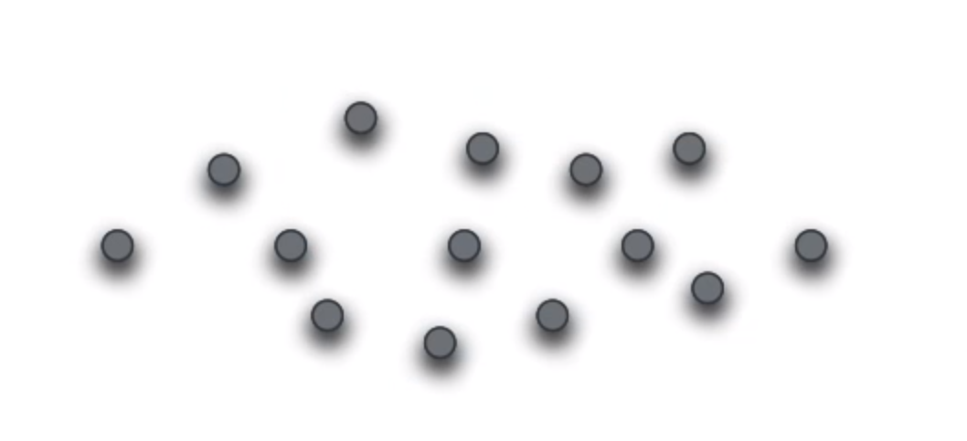
Variance of 2-D data
28
Principal
Component
Analysis
Now suppose we have a 2-D dataset as shown below.
How do we measure variance?
What do we mean by ‘spread out’ now that we have 2 axes?
Do we measure the variance for each axis separately by projecting the data points onto each axis in turn?
Note that the variance can be high even if the data points are strongly correlated.
Diagram by Luis Serrano

Slide 29
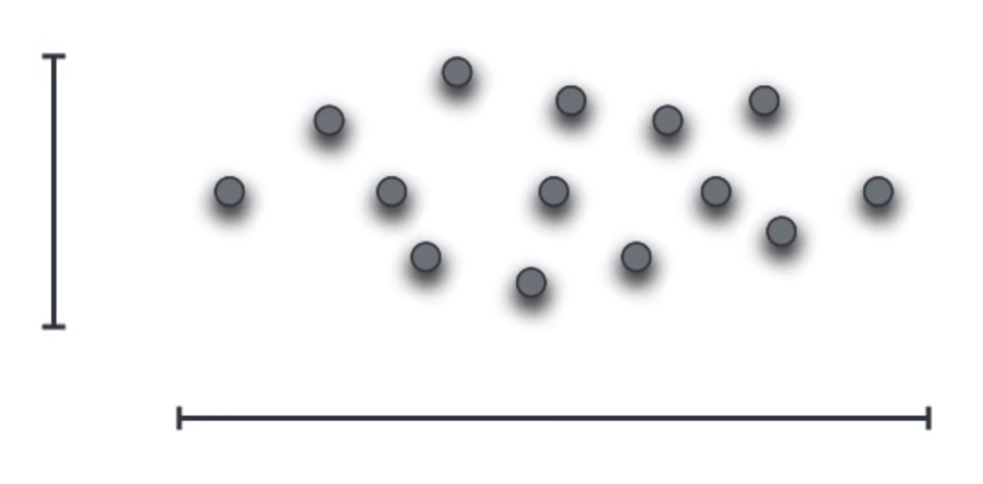
Variance of the x and y axes
29
Principal
Component
Analysis
For the dataset below we can compute the variance for each axis.
The x-variance is the variance of the x values of all the (x, y) data points.
The y-variance is the variance of the y values of the same data points.
This is the same as projecting the data points to the x axis and the y axis.
y-variance
x-variance
Diagram by Luis Serrano

Slide 30
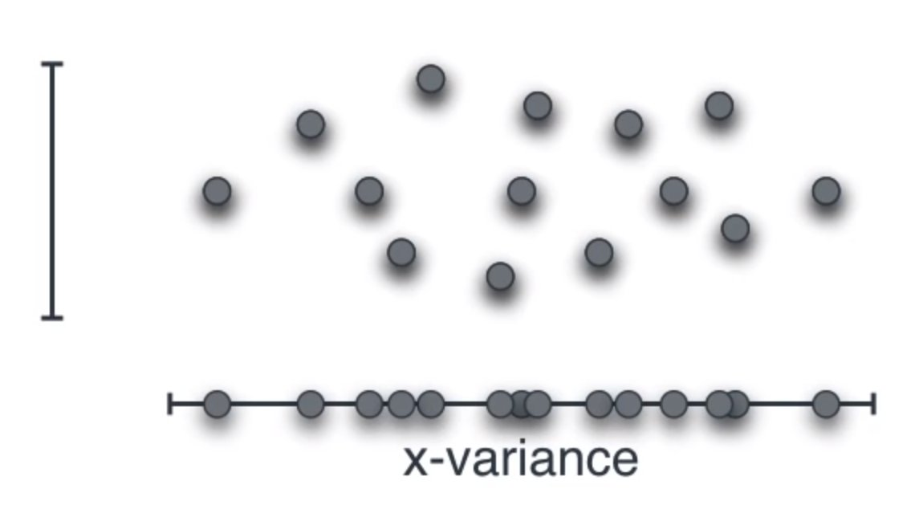
Variance of the x axis
30
Principal
Component
Analysis
For each (x, y) data point ignore the y value and plot the x values on the x axis.
When you do this you ‘lose’ the y ‘information’.
Do you see the similarity to taking pictures of your friends?
Diagram by Luis Serrano

Slide 31


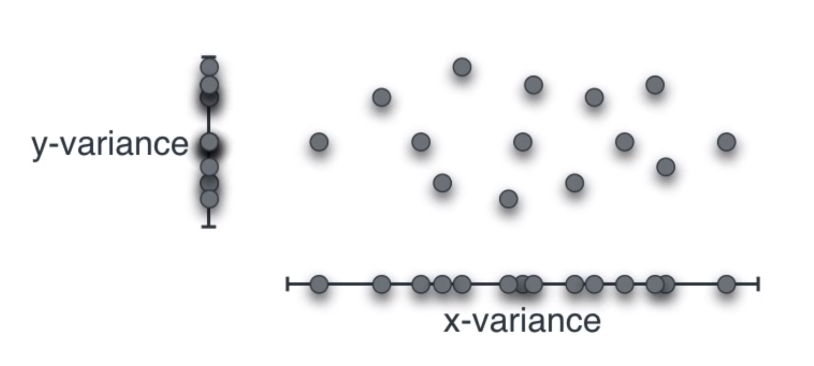
Variance of the x and y axes
31
Principal
Component
Analysis
Do the same for the y axis.
This time we throw away the x ‘information’
Again, do you again see the similarity to taking pictures of your friends?
Do you agree that the projection to the x axis preserves more information than the projection to the y axis?
We are doing dimensionality reduction so if we had to choose between the two variables then it is better to choose x.
Diagram by Luis Serrano

Slide 32
Covariance
32
Principal
Component
Analysis
In the previous example the dataset was aligned with the x and y axes.
The line of best fit was parallel to the x axis and orthogonal to the y axis.
This is rarely the case with real data.
What does one do in such cases?
y-variance
x-variance
Diagram by Luis Serrano

Slide 33
Covariance
33
Principal
Component
Analysis
The 2 datsets below have exactly the same x and y variance.
It is clear that they are different.
y-variance
y-variance
x-variance
x-variance
Diagram by Luis Serrano

Slide 34
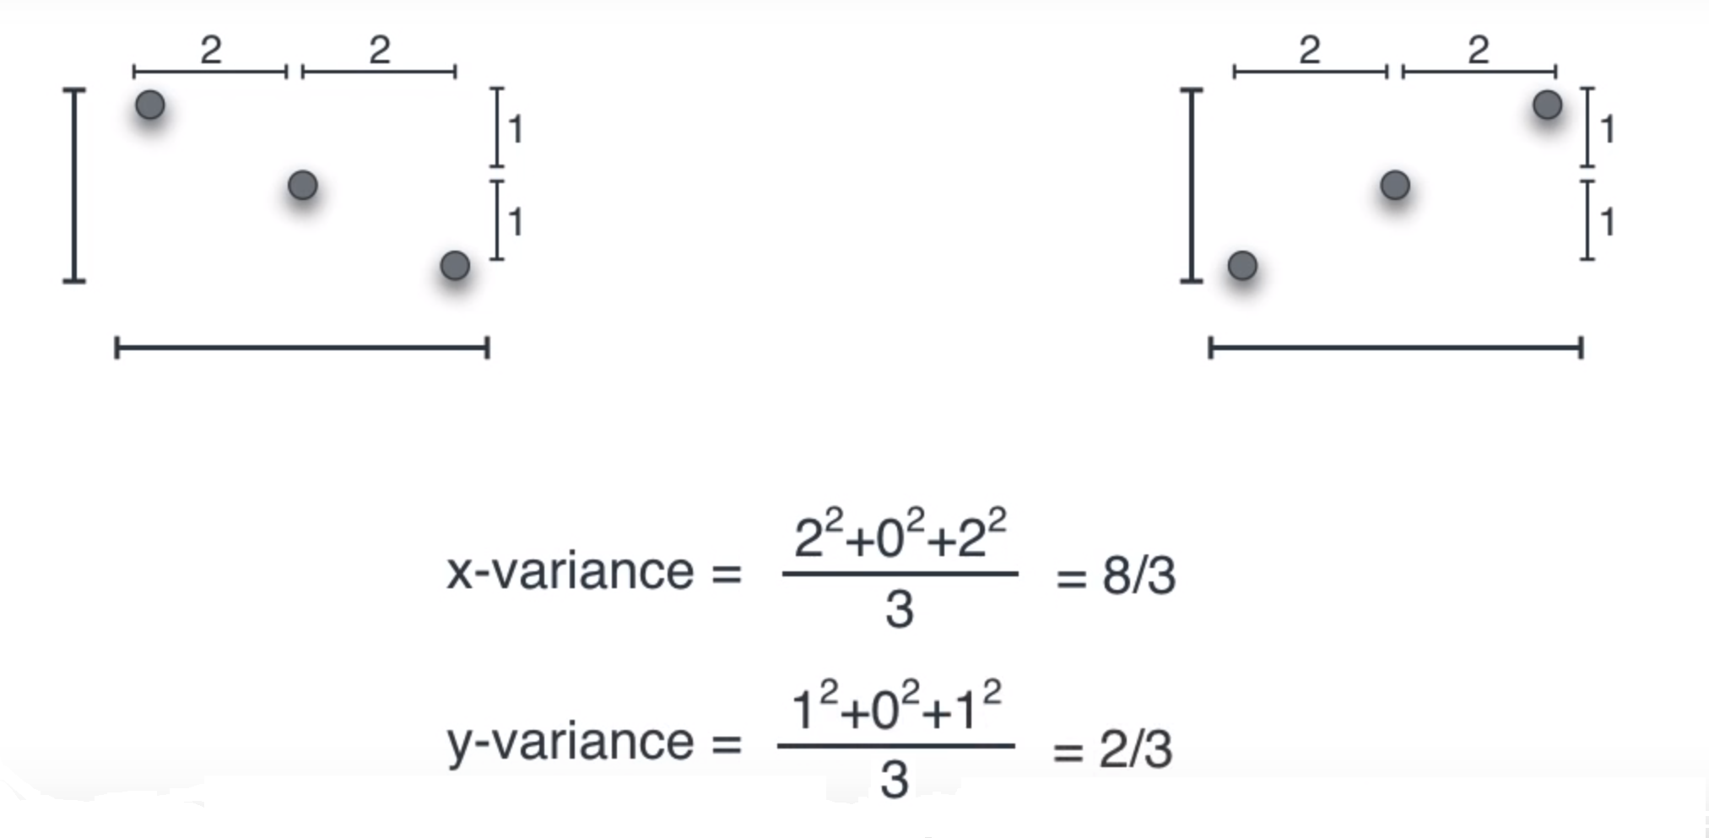
Covariance
34
Principal
Component
Analysis
In the 2 datsets below the middle point is the mean.
Both datsets have the same x and y variance.
Diagram by Luis Serrano

Slide 35
Covariance
35
Principal
Component
Analysis
Consider the set of points below in the Cartesian Plane.
Suppose we have a dataset A (in Green) and a dataset B (in Blue).
Recall that the (axis) variance is the sum of the squares of the differences between each data point and the mean and then divide this sum by the number of points.
For covariance we use the sum of the products of the coordinates.
-2
+2
(-2,1)
(2,1)
(0,0)
0
+2
(-2,-1)
-2
(2,-1)

Slide 36
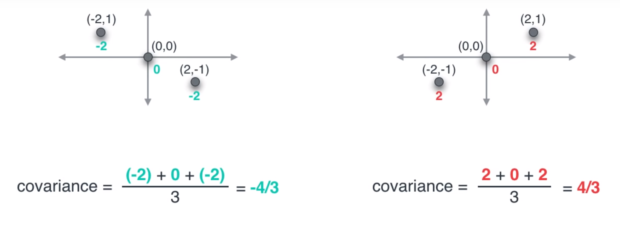
Covariance
36
Principal
Component
Analysis
The covariance for these 2 datasets is different.
Covariance gives us a measure of direction.
Note that covariance is closely related to correlation.
Diagram by Luis Serrano

Slide 37
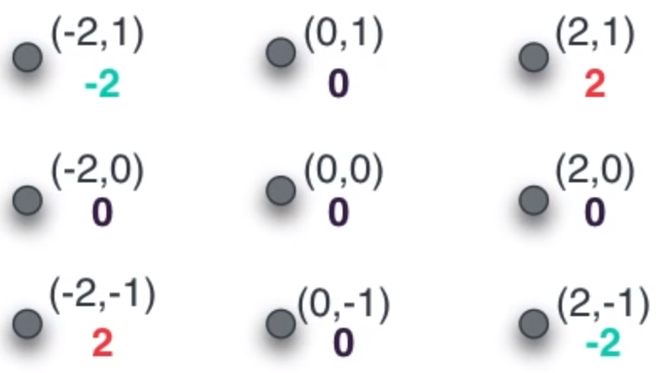
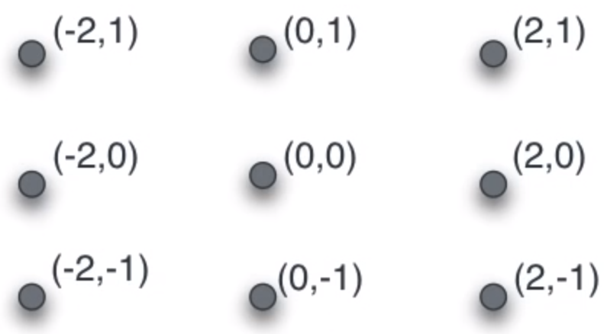
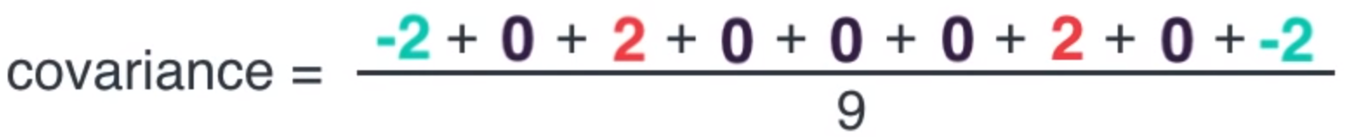
Computing Covariance
37
Principal
Component
Analysis
Diagram by Luis Serrano

Slide 38
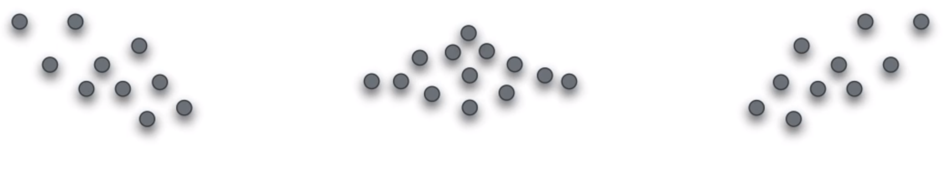
Interpreting Covariance
38
Principal
Component
Analysis
Zero
(or very small)
Covariance
Negative
Covariance
Positive
Covariance
Diagram by Luis Serrano

Slide 39
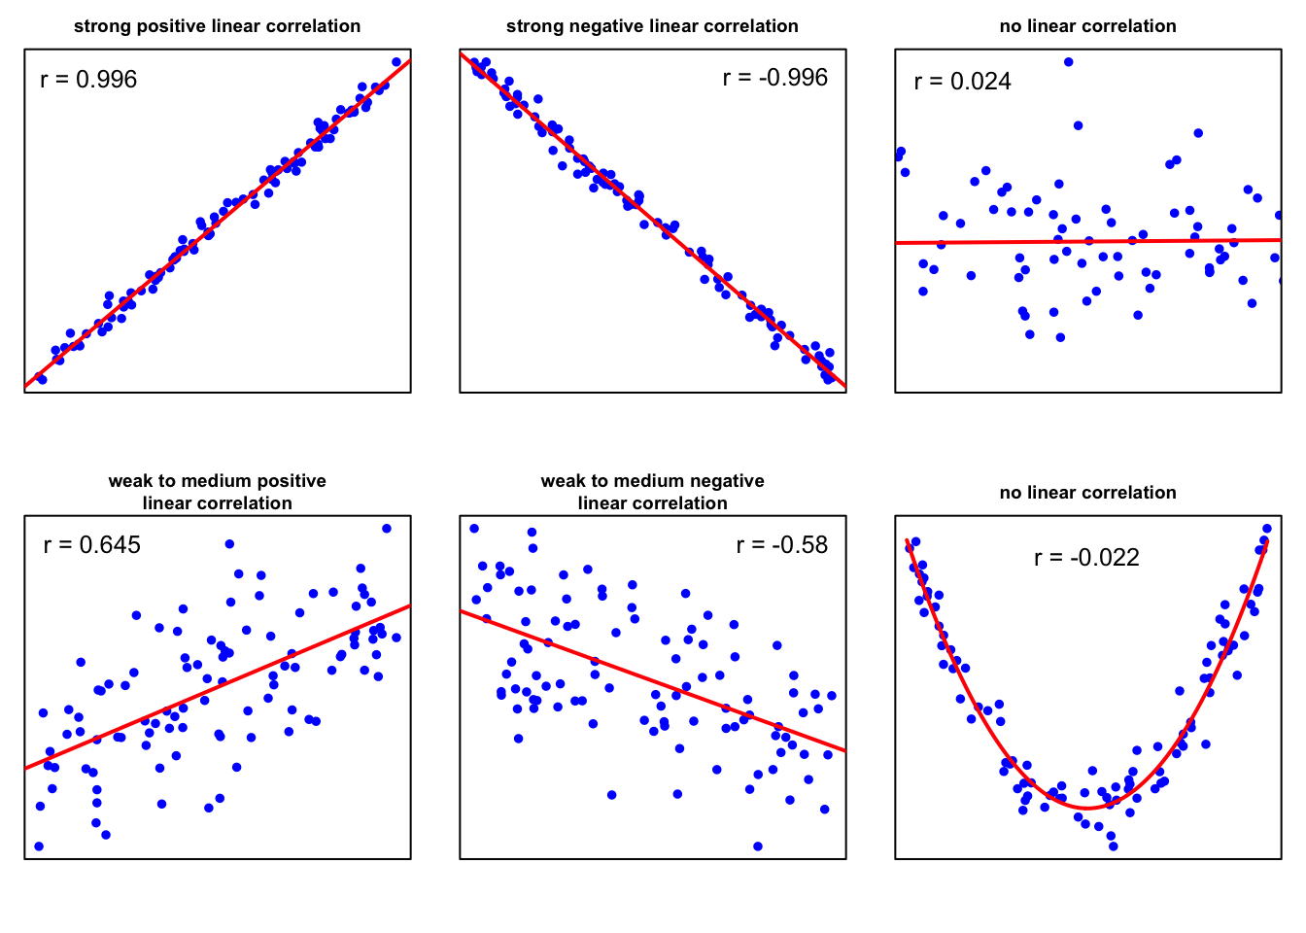
Correlation
39
Principal
Component
Analysis

Slide 40
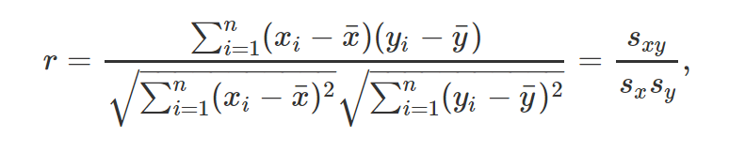


Correlation
40
Principal
Component
Analysis
Correlation is a commonly used method to examine the relationship between quantitative variables. The most commonly used statistic is the linear correlation coefficient, r, which is also known as the Pearson product moment correlation coefficient in honor of its developer, Karl Pearson. Is it given by:
where s_{xy} is the covariance of x and y and s_{x} and s_{y} the standard deviation of x and y, respectively. By dividing by the sample standard deviations, s_{x} and s_{y}, the linear correlation coefficient, r, becomes scale independent and takes values between −1 and 1.
The linear correlation coefficient measures the strength of the linear relationship between
two variables. If r is close to ±1, the two variables are highly correlated and if plotted on a scatter plot, the data points cluster about a line. If r is far from ±1, the data points are more widely scattered. If r is near 0, the data points are essentially scattered about a horizontal line indicating that there is almost no linear relationship between the variables.

Slide 41

Covariance vs Correlation
41
Principal
Component
Analysis
Note that covariance is the main concept that you must know to understand PCA.
In probability theory and statistics, the mathematical concepts of covariance and correlation are very similar. Both describe the degree to which two random variables or sets of random variables tend to deviate from their expected values in similar ways.
Covariance is nothing but a measure of correlation. On the other hand, correlation refers to the scaled form of covariance.
The value of correlation takes place between -1 and +1. Conversely, the value of covariance lies between -∞ and +∞.
Covariance is affected by the change in scale, i.e. if all the values of one variable are multiplied by a constant and all the values of another variable are multiplied, by a similar or different constant, then the covariance is changed. Correlation is not influenced by the change in scale. Correlation is normalized.
Correlation is dimensionless, i.e. it is a unit-free measure of the relationship between variables. Unlike covariance, where the value is obtained by the product of the coordinates of the two variables.

Slide 42
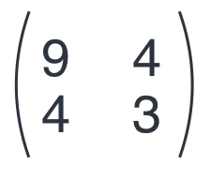
Covariance Matrix
42
Principal
Component
Analysis
y-variance
x-variance
Var(X)
Cov(X,Y)
∑ =
Cov(X,Y)
Var(Y)
Diagram by Luis Serrano

Slide 43
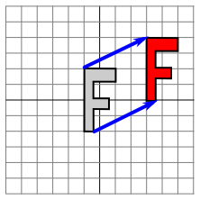
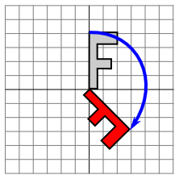
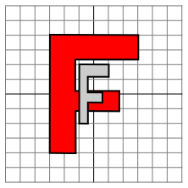

Linear Transformations
43
Principal
Component
Analysis
A linear transformation is a mapping from one vector space to another that obeys certain conditions.
In the Cartesian Plane, Scale, Reflection, Rotation, and Shear are all linear transformations.
They satisfy: T(au + bv) = aT(u) + bT(v)
u and v are vectors
a and b are scalars
If T is a linear transformation, then T((0, 0)) = (0, 0) must hold.
Translation
Not a linear transformation
Rotation
Scaling
Shear

Slide 44
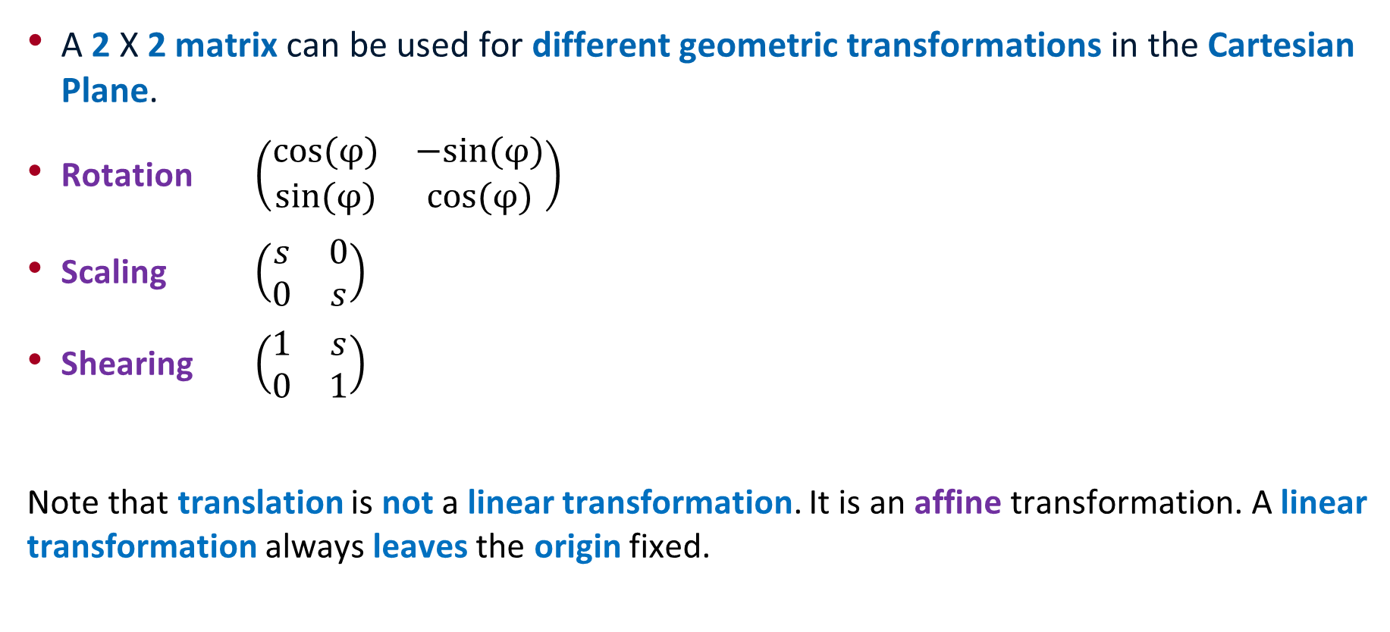
Some Linear Transformations
44
Principal
Component
Analysis
A 2 X 2 matrix can be used for different geometric transformations in the Cartesian Plane.
Rotation $\left(\begin{matrix}cos⁡(φ) & −sin⁡(φ) \\ sin⁡(φ) & cos⁡(φ)\end{matrix}\right)$
Scaling $\left(\begin{matrix}s & 0 \\ 0 & s\end{matrix}\right)$
Shearing $\left(\begin{matrix}1 & s \\ 0 & 1\end{matrix}\right)$
Note that translation is not a linear transformation. It is an affine transformation. A linear transformation always leaves the origin fixed.

Slide 45
Linear Transformations
45
Principal
Component
Analysis
A linear transformation in the Cartesian Plane can be represented (and specified) by a 2 X 2 matrix.
If we multiply a point (x, y), expressed as a 2 X 1 column vector, by the matrix the point will be ‘mapped’ to another point on the Cartesian plane.
The point (x, y) is therefore mapped to the point a₁₁x + a₁₂y, a₂₁x + a₂₂y.

Slide 46
Linear Transformations
46
Principal
Component
Analysis
(a₁₁x + a₁₂y, a₂₁x + a₂₂y)
(x, y)

Slide 47
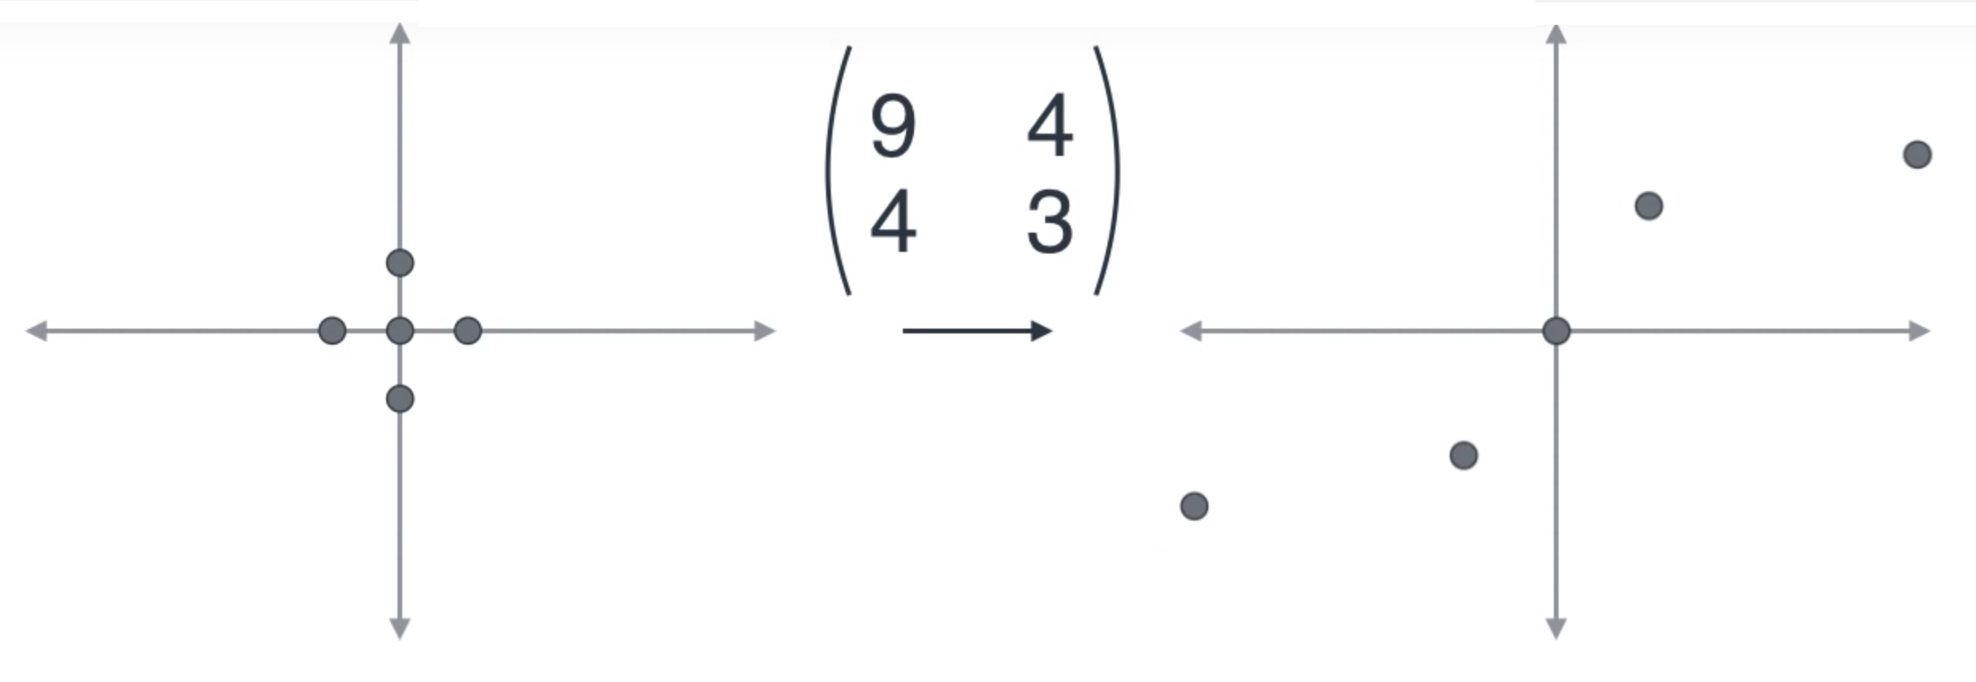
Linear Transformations
47
Principal
Component
Analysis
(x, y) (9x+4y, 4x+3y)
(0, 0) (0, 0)
(1, 0) (9, 4)
(0, 1) (4, 3)
(-1, 0) (-9, -4)
(0, -1) (-4, -3)
Diagram by Luis Serrano

Slide 48
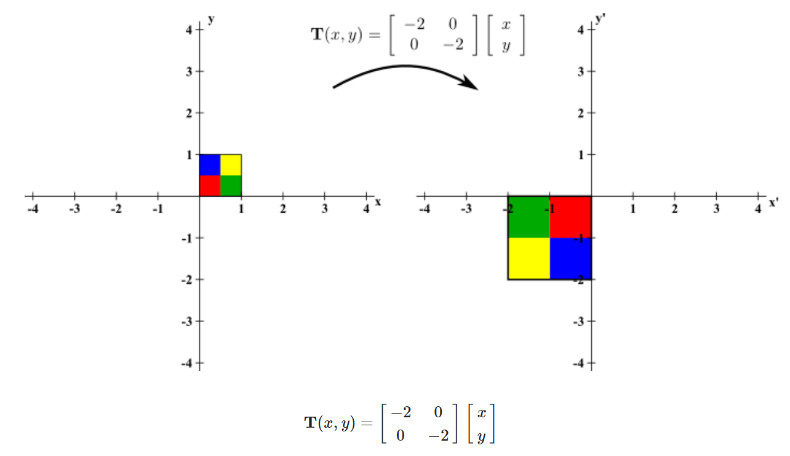
Determinants of a Linear Transformation
48
Principal
Component
Analysis
Informally, the determinant of a linear transformation in the Cartesian Plane represents the change in volume that results when the transformation is applied to a shape.
In this example, the determinant is 4.
Note also that the transformation effects a rotation about the origin.

Slide 49
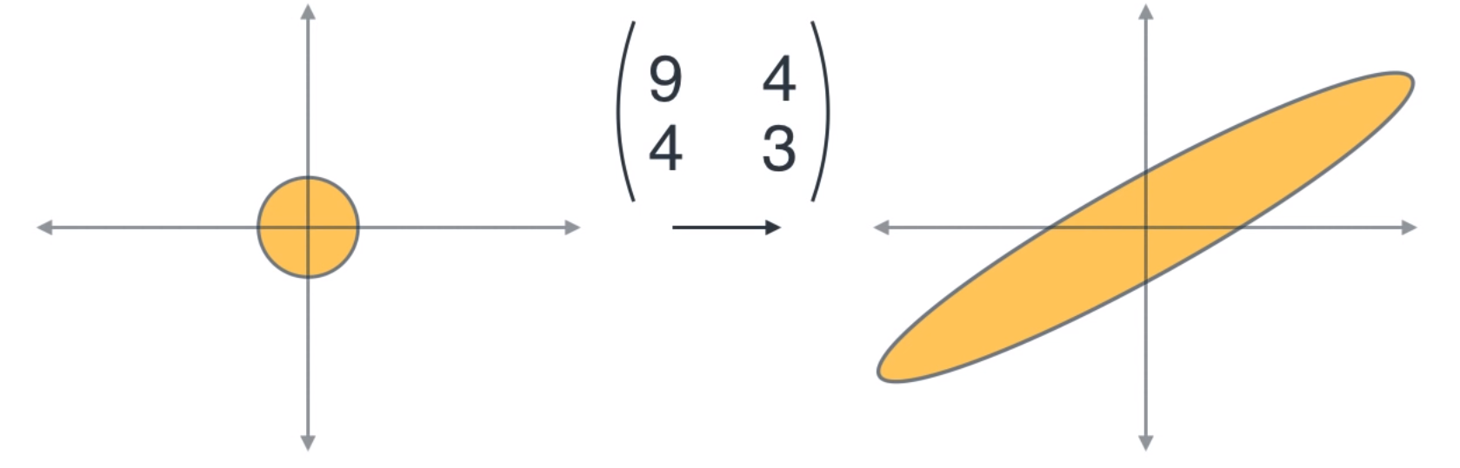
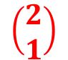
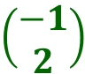
Eigenvectors and Eigenvalues
49
Principal
Component
Analysis
Eigenvectors
(direction)
$$\left(\begin{aligned}−1 \\ 2\end{aligned}\right)$$
$$\left(\begin{aligned}2 \\ 1\end{aligned}\right)$$
11
1
Eigenvalues
(magnitude)
A linear transformation may have eigenvectors and eigenvalues.
Note that our matrix is diagonal. This will mean that the eigenvectors will always be orthogonal to each other. The eigenvalues will be real-valued.
Diagram by Luis Serrano

Slide 50
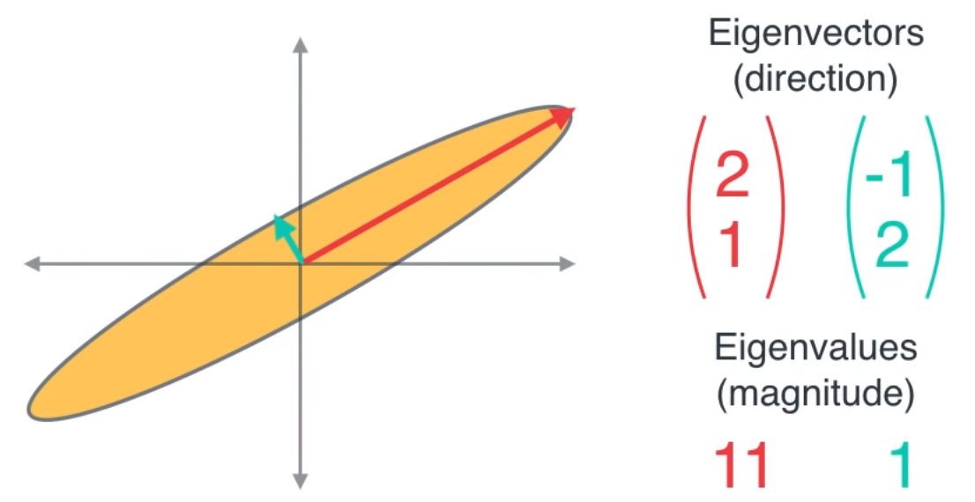
Eigenvectors and Eigenvalues
50
Principal
Component
Analysis
Diagram by Luis Serrano

Slide 51
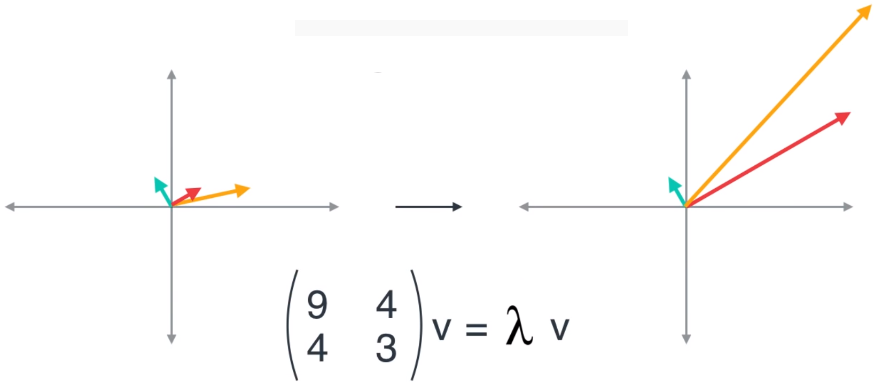
Eigenvectors and Eigenvalues
51
Principal
Component
Analysis
Eigenvectors
Eigenvalue
Diagram by Luis Serrano

Slide 52
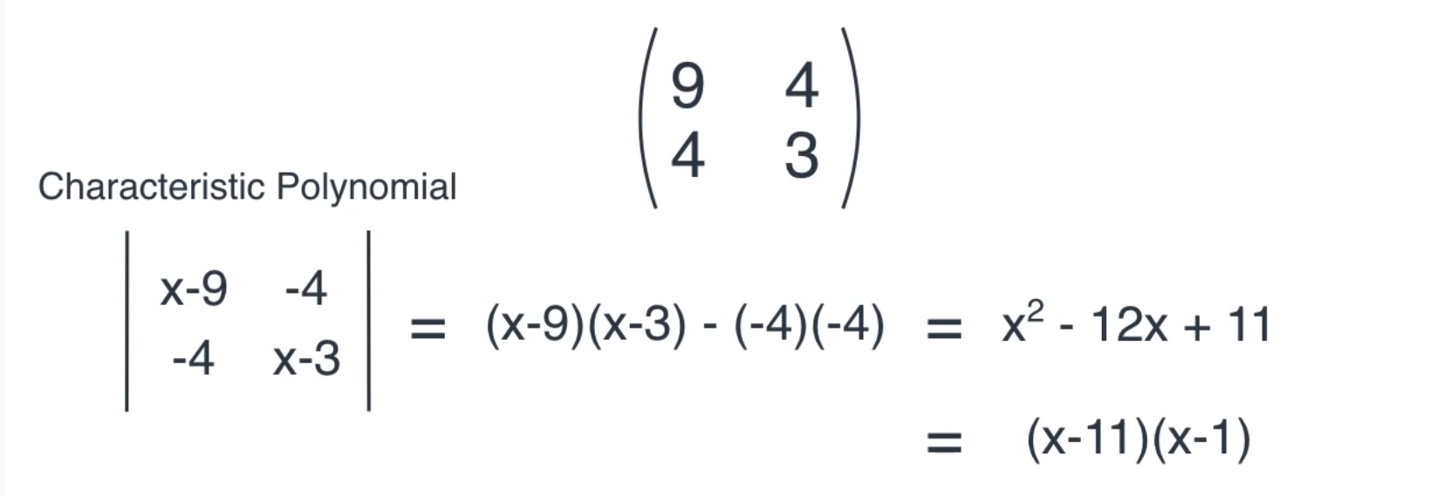
Finding the Eigenvalues of a 2 X 2 Matrix
52
Principal
Component
Analysis
Eigenvalues
Diagram by Luis Serrano

Slide 53
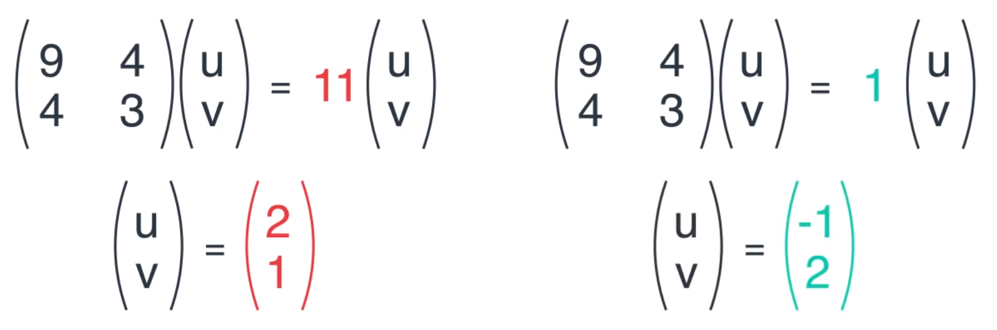
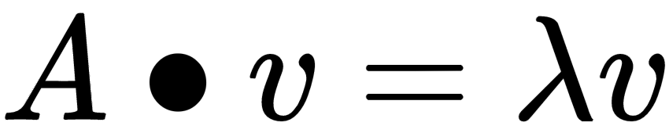
Finding the Eigenvectors of a 2 X 2 Matrix
53
Principal
Component
Analysis
Eigenvectors
Diagram by Luis Serrano

Slide 54
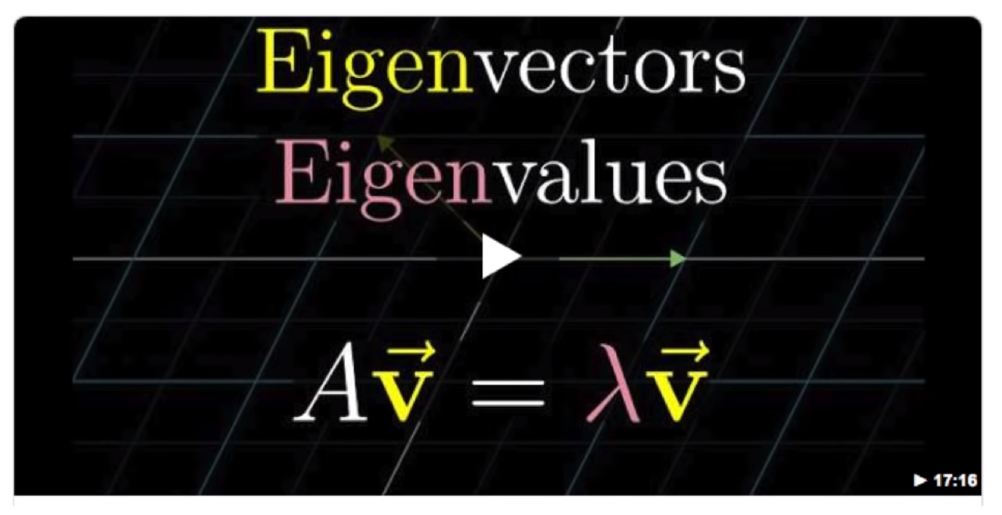

YouTube video on Eigenvectors & Eigenvalues
54
Principal
Component
Analysis

Slide 55
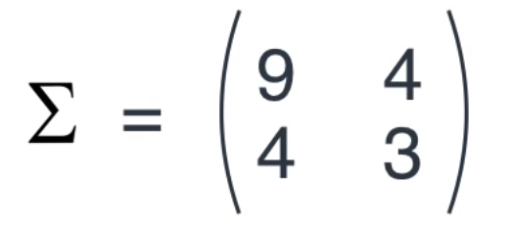
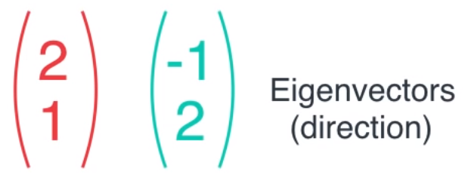

Finding the Principal Components
55
Principal
Component
Analysis
Covariance Matrix
Diagram by Luis Serrano

Slide 56

Choosing a winning Eigenvector
56
Principal
Component
Analysis
Covariance Matrix
Diagram by Luis Serrano

Slide 57

What have we done?
57
Principal
Component
Analysis
2-D
Data
1-D
Data
Diagram by Luis Serrano

Slide 58









How does PCA work?
58
Principal
Component
Analysis
Covariance matrix
Eigenvectors & Eigenvalues
Large Table
Small Table
2-D Plot
5-D Plot
Diagram by Luis Serrano

Slide 59


What have we done?
59
Principal
Component
Analysis

Slide 60

60
Principal
Component
Analysis
Principle Component Analysis

